Slide 1

Journey to the Cloud (DevOps)
Title: Overview of DevOps
beCloudReady

Slide 2
Agenda
Overview of DevOps
Goal of DevOps
Evolution of DevOps
Job Trends
DevOps Top skills
Training Overview

Slide 3
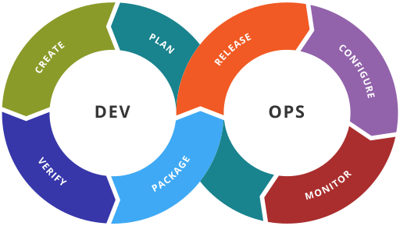
DevOps

Slide 4
Goals of DevOps
It’s a philosophy
Reduce Organization silos
Accept failures, and act on them
Implement gradual changes
Tooling and Automation

Slide 5
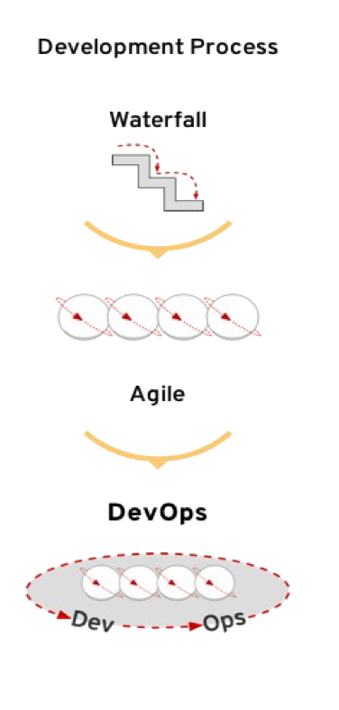
Driving force for DevOps – Software Delivery/Development
Dramatic Changes in software delivery mode
Fast paced development and Agile based SDLC
Small and incremental changes and rapid deployment
Software release cycle changed from yearly to weekly!
Tremendous pressure on deployment pipeline
Lead to end to end automation of delivery pipeline.

Slide 6
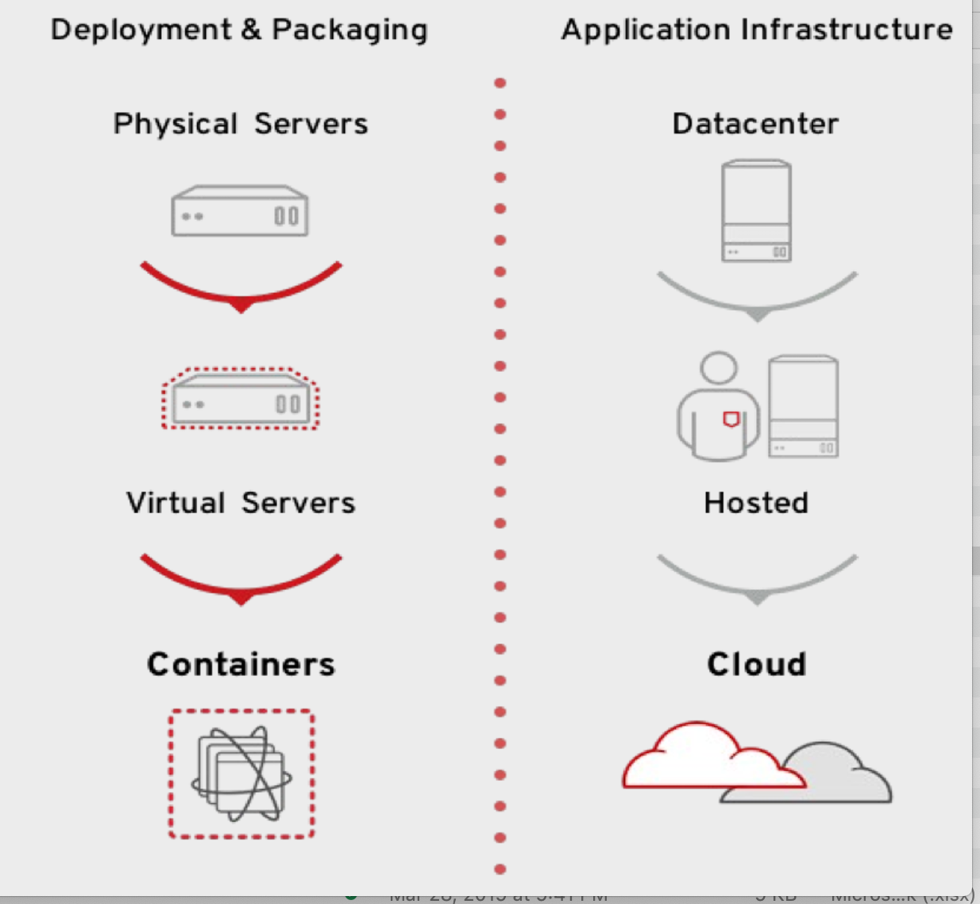
Driving force for DevOps - Infrastructure
Rising Data center complexity
From single server to large number of containers.
From regular data center to complex Hybride Cloud ( Private + Public )

Slide 7
DevOps ( Development Operations )
Linux Admin
Configuration Manager
Build Automation Engineer
Developer
Test Automation
Platform Operation Orchestration

Slide 8
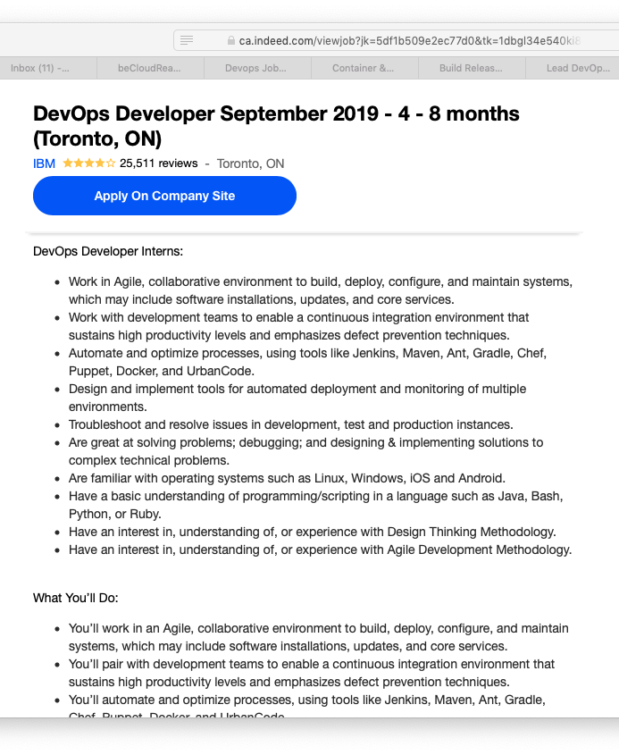
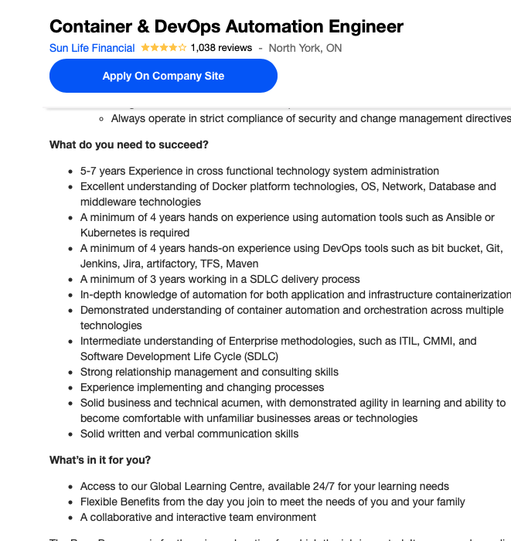
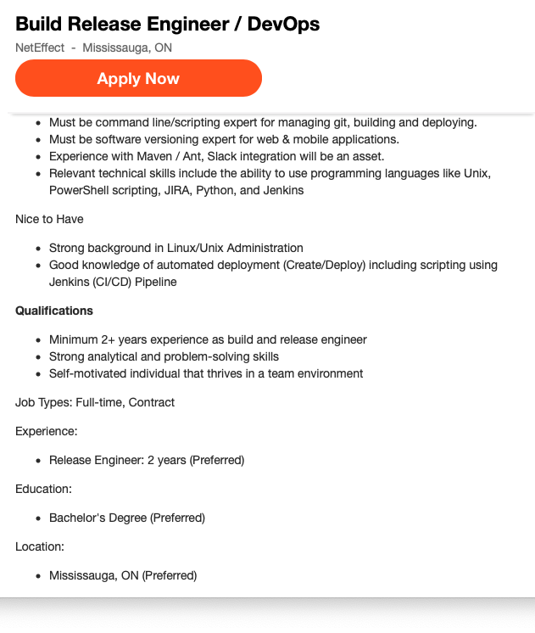
Job Listings

Slide 9
Top Skills
Linux
Git
Jenkins
Ansible
Docker
Python ( Cherry on Top )
Cloud ( AWS )

Slide 10
Trainings offered
Ansible Training with AWS, Git & Docker
Python Training with AWS Git & Docker
CI/CD using Jenkins ( Git, AWS, Docker )

Slide 11
Not Only this
Internship
Live project working experience
Career services
Mock Interview Preparation
Resume service ( SEO’ing the CV )
Referral to Recruiter community
Life long Q/A support on our Forum

Slide 12
Questions?

